Slide 1

Project Title - Seasonal Agriculture Performance Analysis
Student Name – Mohit sahi
College Name - Dr. A.P.J. Abdul Kalam Government Institute of Technolgy, Tanakpur, Champawat
AICTE STU ID : (STU6a64775ba18a11784969051)

Slide 2

PROBLEM STATEMENT
(Agricultural activities are influenced by seasonal variations in environmental conditions, farming practices, resource availability and market conditions. As a result, agricultural performance may differ from one season to another. However, raw agricultural data does not clearly explain how agricultural performance changes across seasons or what patterns can be observed in different seasonal conditions. The problem is to analyze the given agricultural dataset and investigate seasonal differences in agricultural performance by identifying meaningful patterns, trends, relationships and variations within the available data.

Slide 3
Project Description -
[This project analyzes agricultural data across different seasons, crops and geographical regions. It focuses on yield, environmental conditions, resource usage and economic performance to identify useful patterns and trends.]

Slide 4

WHO ARE THE END USERS?
  Farmers
  Researchers
  Agriculture Departments
  Agricultural Planners
  Data Analysts

Slide 5

Technology Used
  Python
  Jupyter Notebook
  Pandas
  NumPy
  Matplotlib
  Seaborn
  SciPy

Slide 6
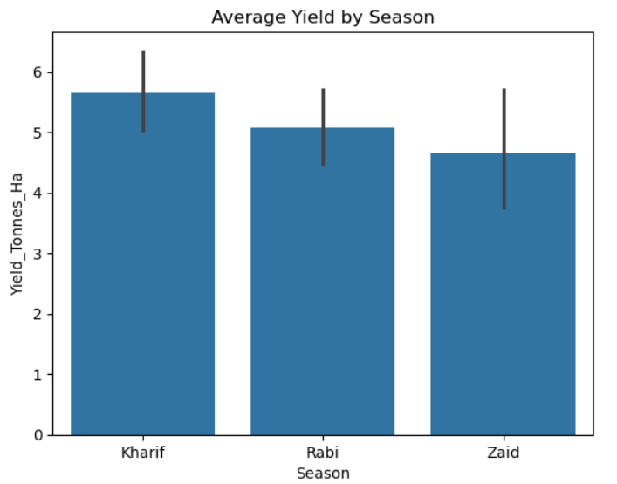
RESULTS

Slide 7
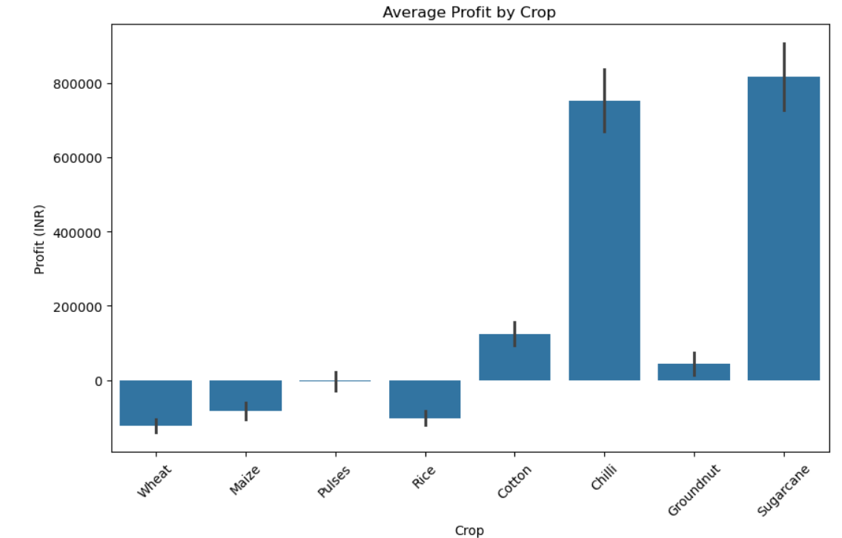
RESULTS

Slide 8
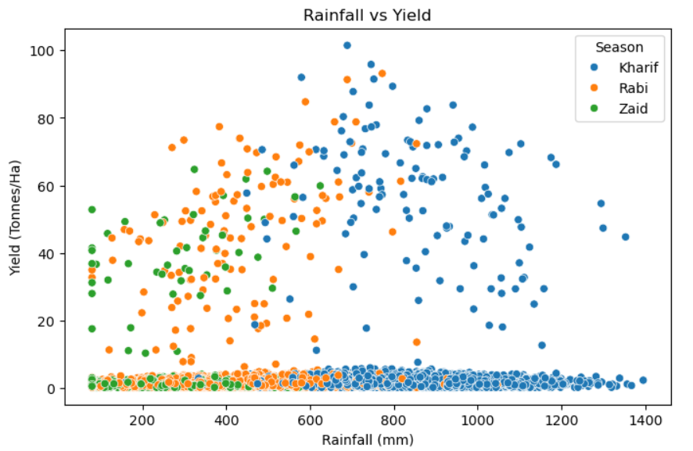
RESULTS

Slide 9
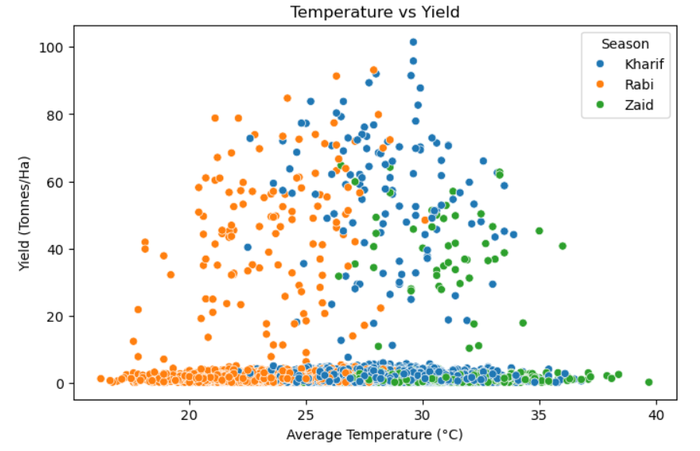
RESULTS

Slide 10
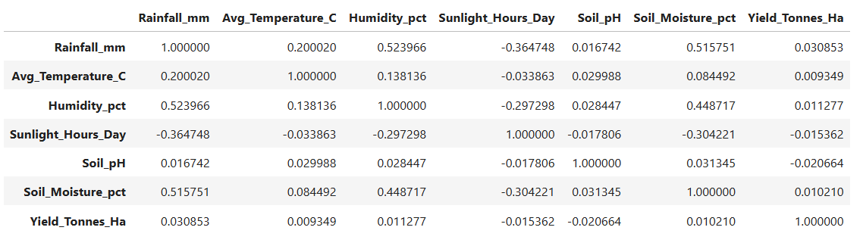
RESULTS

Slide 11
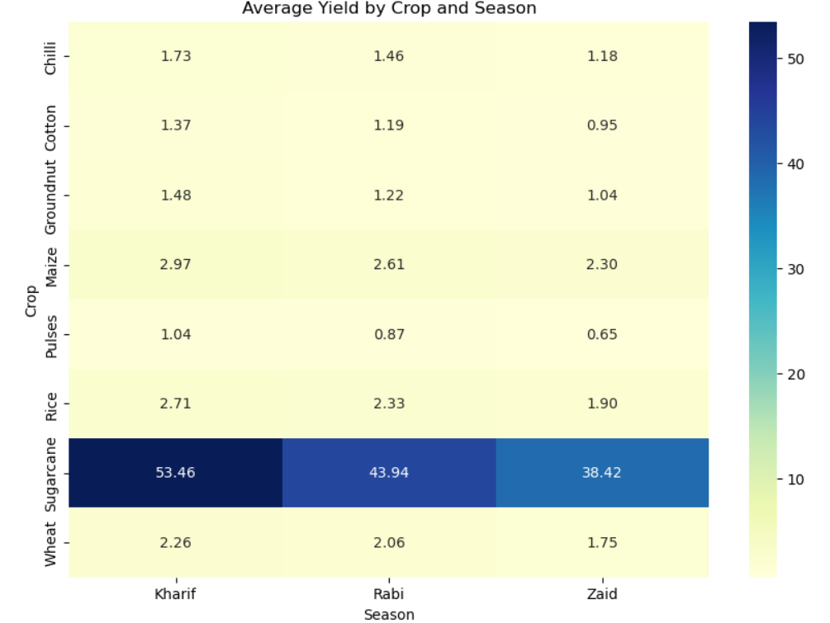
RESULTS

Slide 12
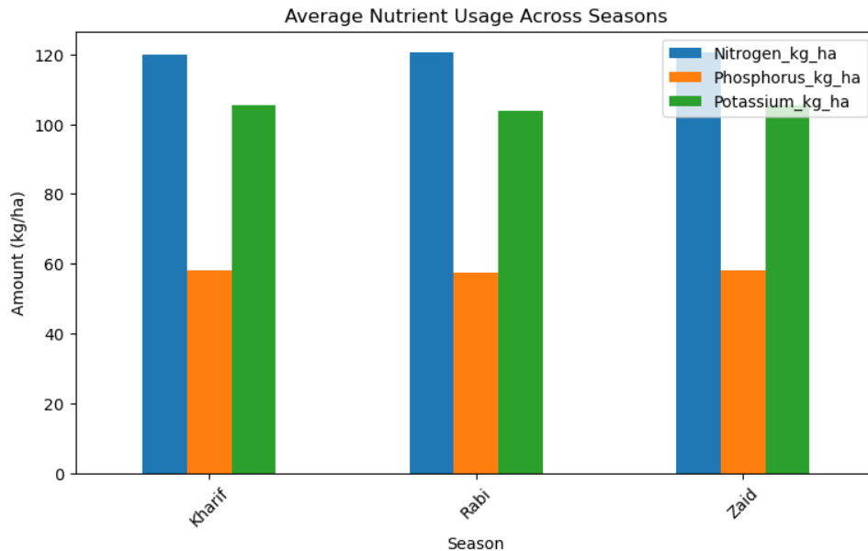
RESULTS

Slide 13
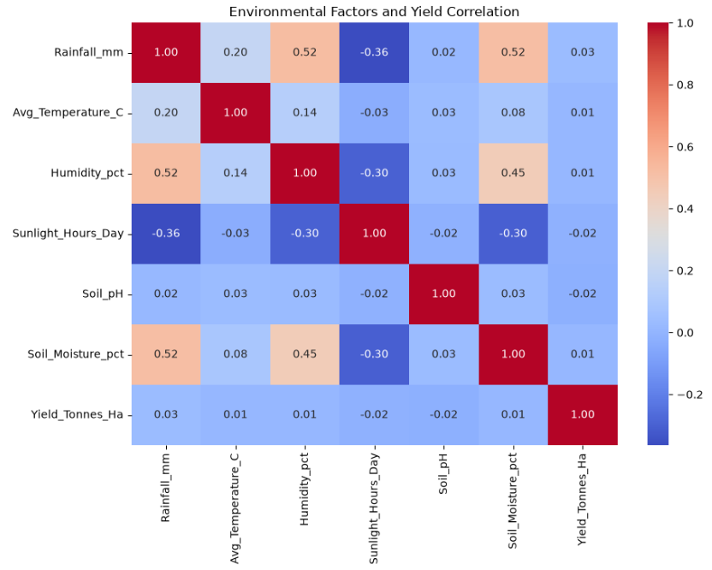
RESULTS

Slide 14
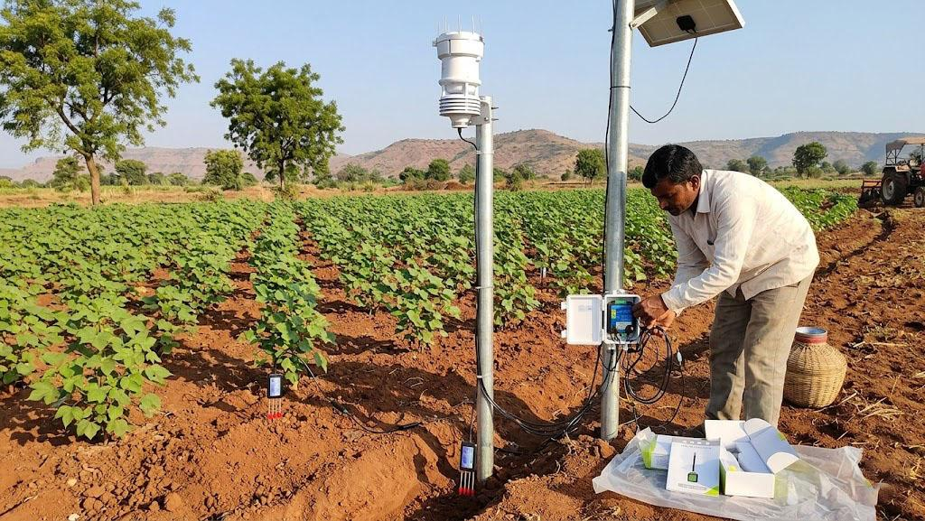
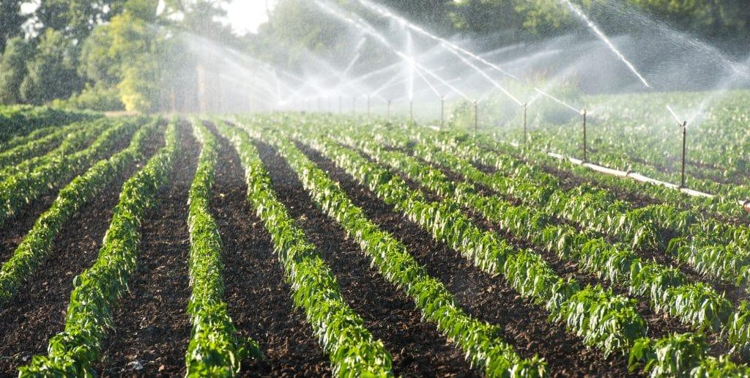
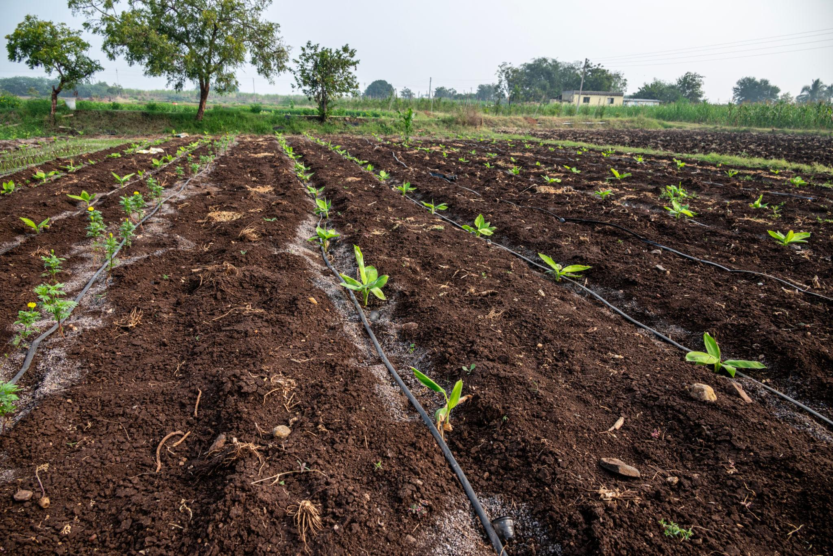
Future scope -

Slide 15

Future scope -
Yield Prediction
Use weather, soil and past farm data to predict crop yield earlier.
Smart Farming
Use AI, sensors and digital tools for better farm decisions.
Resource Optimization
Reduce unnecessary water and fertilizer use through smarter planning.
Real-Time Monitoring
Add sensor and satellite data to monitor crop conditions during the season.
Weather-Based Planning
Use weather and climate information to plan crops according to seasonal conditions.

Slide 16
GitHub Link
https://github.com/mohitsahi11/Seasonal-Agriculture-Performance-Analysis

Slide 17

VOIS Course completion certificate -
Course name- Data Visualization

Slide 18
Thank you
.
.

